Slide 1
Adding Subversion Web Services to OSLC Adapters
Axel Reichwein
July 28, 2015

Slide 2
Classes/Files affected
Non Java files
Pom.xml
Config.properties file
New Folder with Subversion-specific JSP files
Java files
OSLC4J[….]Application
[…]Manager
ServiceProviderService
ServiceProviderCatalogSingleton

Slide 3
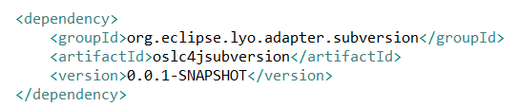
Pom.xml
New dependency to Subversion Maven project

Slide 4
Config.properties file
New user-defined property

Slide 5
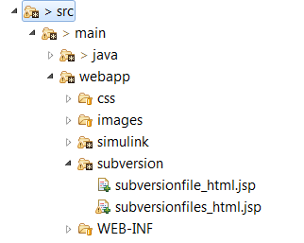
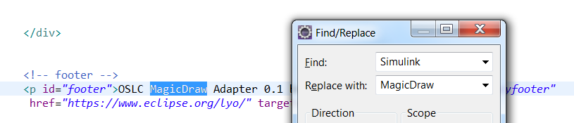
Add package with JSP files
The JSPs are loaded based on the root of the web application.
In JSPs, replace […] by name of adapter

Slide 6

OSLC4J[…]Application
Define static variables
delayInSecondsBetweenDataRefresh
subversionManager variable

Slide 7
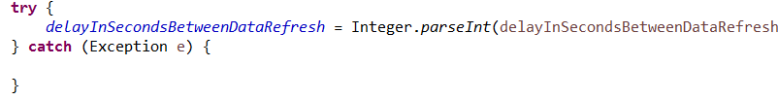
OSLC4J[…]Application
delayInSecondsBetweenDataRefresh Property parsing code

Slide 8
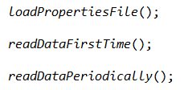
OSLC4J[…]Application
Method calls
Additional registration of resource class (for RDF serializarion)

Slide 9
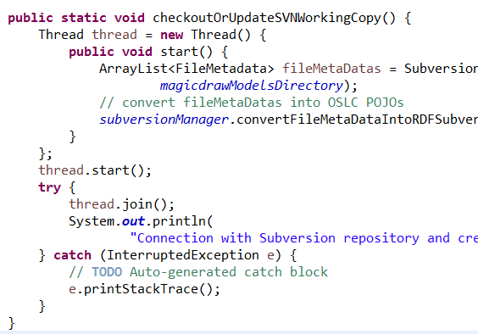
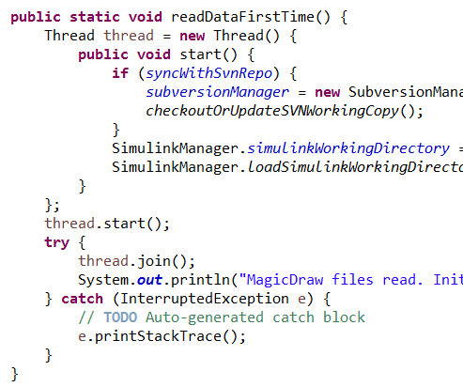
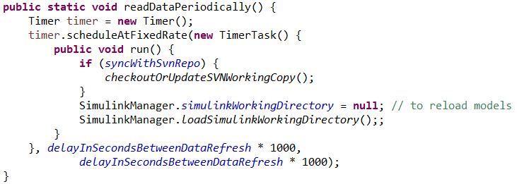
OSLC4J[…]Application
New method
checkoutOrUpdateWorkingCopy()
readDataFirstTime()
readDataPeriodically()

Slide 10
[…]Manager
Make main method to load data synchronized

Slide 11

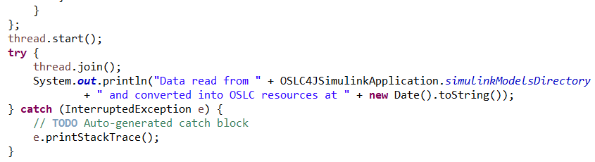
[…]Manager
Add the thread so that you can log the exact time to read and convert data into OSLC POJOs

Slide 12

ServiceProviderService
In method getHtmlServiceProvider(), add

Slide 13
ServiceProviderCatalogSingleton
Make method initServiceProvidersFromProjects() synchronized

Slide 14
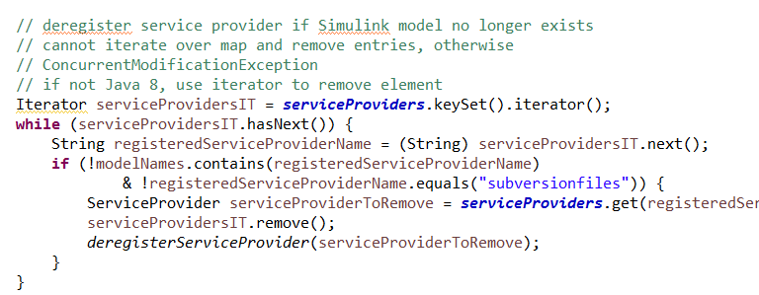
ServiceProviderCatalogSingleton
In method initServiceProvidersFromProjects()
Remove serviceProviders as they may change after reloading data

Slide 15
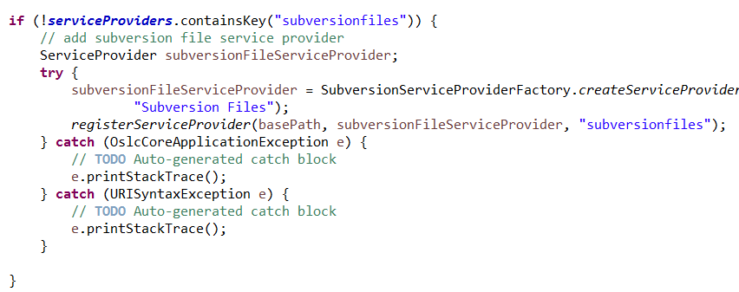
ServiceProviderCatalogSingleton
In method initServiceProvidersFromProjects()
register subversion serviceProvider

Slide 16
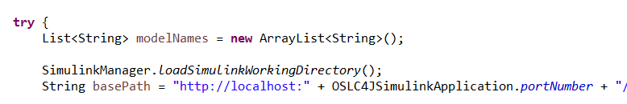
ServiceProviderCatalogSingleton
In method initServiceProvidersFromProjects()
New variables if necessary

Slide 17
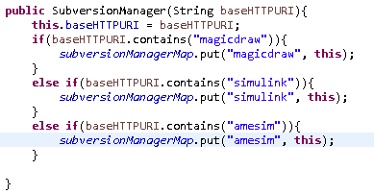
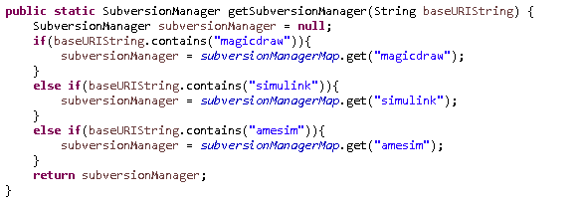
Register […] SubversionManager
In SubversionManager constructor and getter method

Slide 18
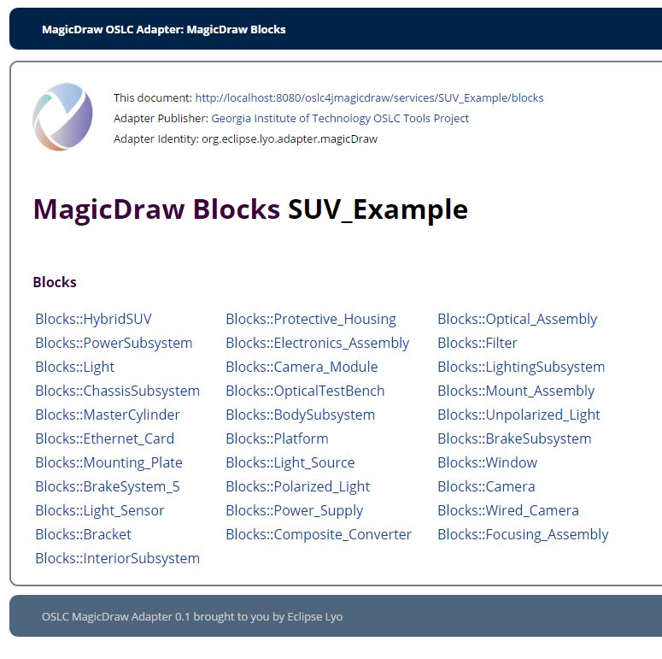
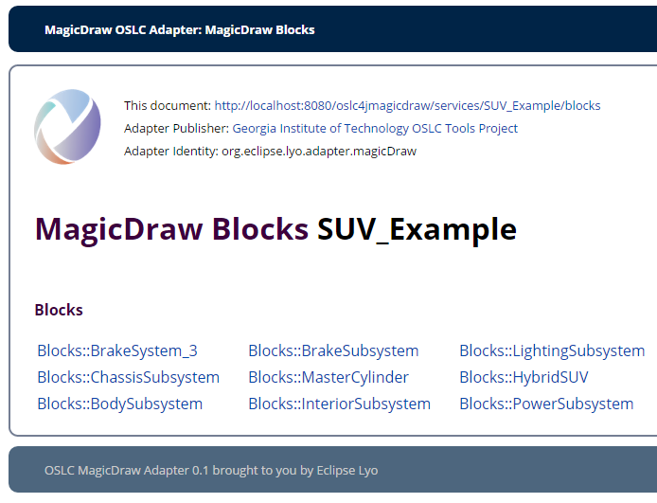
Problem
Addition of blocks of 2 different models!!

Slide 19
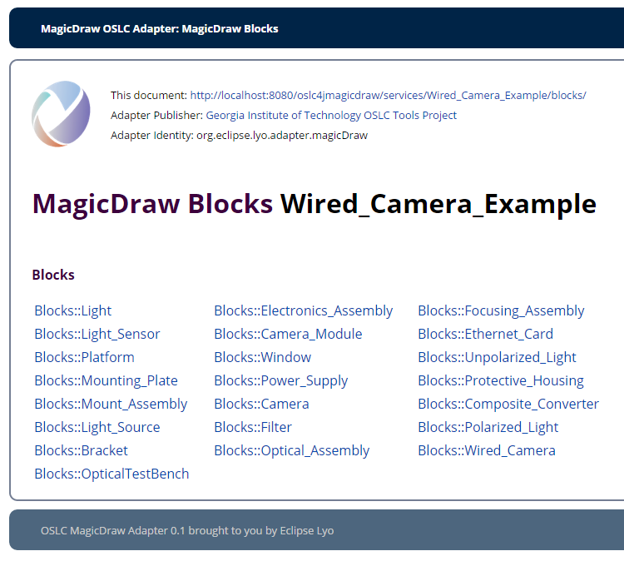

Slide 20
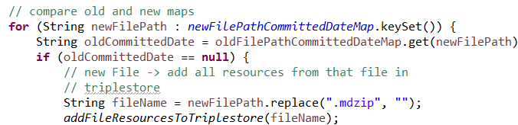
Syncing Clients
Do not forget to remove the file ending (.mdzip or .slx)!!

